Slide 1
Bayesian integrated population modeling using JAGS State-space models

Slide 2
Introduction
State-space models (SSM) provide a general framework for analyzing deterministic and stochastic systems that are measured or observed through a stochastic process
Applied in engineering, statistics, computer science and economics to solve a broad range of dynamical systems problems
The term state space originated in 1960s in the area of control engineering (Kalman 1960)
A well studied SSM is the Kalman filter, which defines an algorithm for linear Gaussian systems
SSM are also known as hidden Markov models (HMM) or latent process models
SSM are composed of 2 sets of equations:
State process equations: describe the development of the true state of a system over time
Observation equations: relate the true state to the observation
Notes:
A state space model is a model that runs two time series in parallel, one capture the dynamics of the true (latent) state and the other consists of observations that are made from these underlying but possibly unknown states.
If the state process is Markovian, that is, if the current state only depends on the previous state, then the model is also called a Hidden Markov Model.
Kalman RE. (1960) A new approach to linear filtering and prediction problems. Transactions of the ASME--Journal of Basic Engineering, 82:35-45.

Slide 3
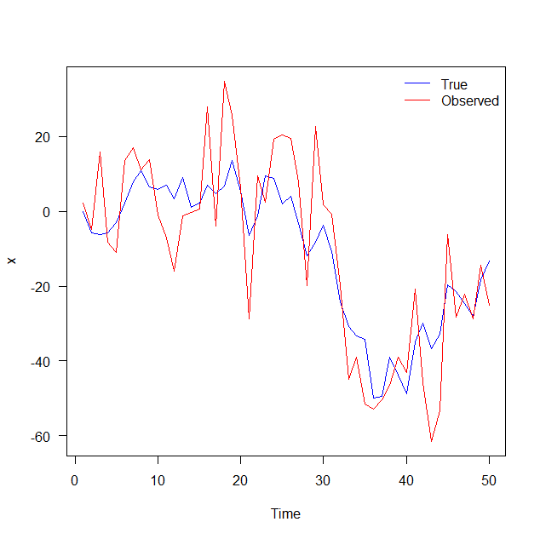
Example 1: random walk with noise
Data simulation with:

Slide 4
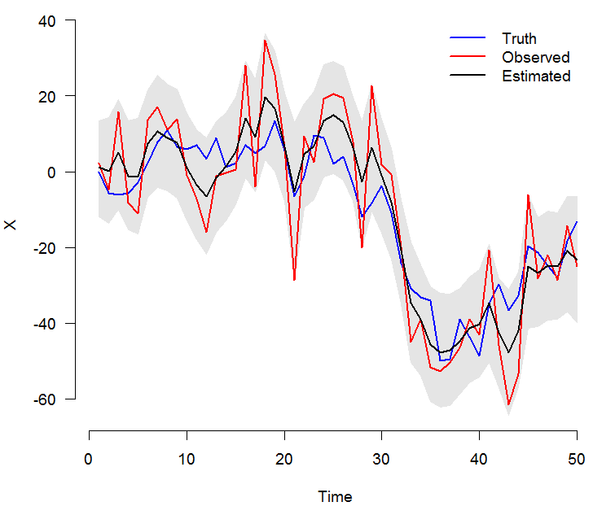
Example 1: random walk with noise
Analysis in JAGS
Estimates:
mean sd 2.5% 50% 97.5% overlap0 f Rhat n.eff
x[1] -1.457 6.310 -13.943 -1.494 10.397 TRUE 0.598 1.000 4002
...
sigma1 7.521 2.449 3.787 7.110 13.267 FALSE 1.000 1.032 79
sigma2 11.539 1.893 7.672 11.549 15.266 FALSE 1.000 1.010 247

Slide 5
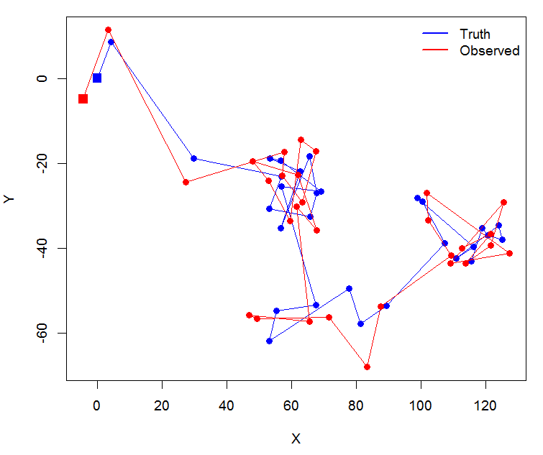
Example 2: movement pattern with noise
Data simulation with:

Slide 6
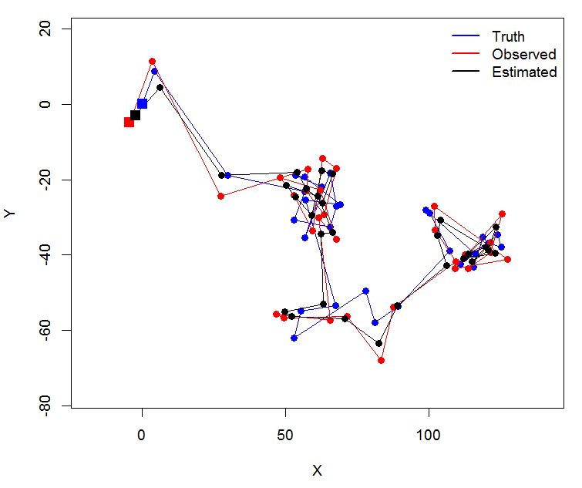
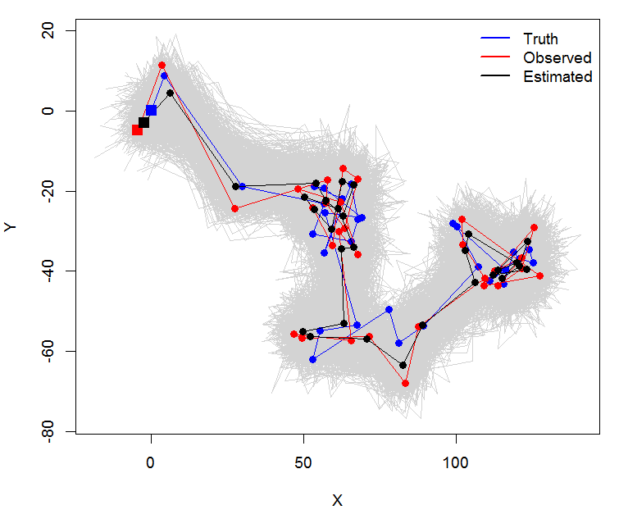
Example 2: movement pattern with noise
Analysis in JAGS
mean sd 2.5% 50% 97.5% overlap0 f Rhat n.eff
sigmaX 12.692 2.148 9.017 12.572 17.528 FALSE 1.000 1.003 558
sigmaY 10.057 2.563 5.647 9.875 15.177 FALSE 1.000 1.000 1251
sigma.obs 4.699 2.114 0.440 4.893 8.558 FALSE 1.000 1.010 323

Slide 7
Application to count data
Data: annual counts (a time-series) from a population
Aims:
Understand dynamics of the population (population growth rate, density-dependence, impact of environment)
Predict the behaviour in the future
Classical time-series analyses such as described in Dennis et al. (1991) or Lande et al. (2003)
Challenge: count data are usually not free from observation errors
Idea: use state-space models (SSM) to analyse such time-series of counts (e.g. Lindley 2003; Buckland et al. 2004; Dennis et al. 2006; Flesch 2014)
Notes:
A state space model is a model that runs two time series in parallel, one capture the dynamics of the true (latent) state and the other consists of observations that are made from these underlying but possibly unknown states.
If the state process is Markovian, that is, if the current state only depends on the previous state, then the model is also called a Hidden Markov Model.
Kalman RE. (1960) A new approach to linear filtering and prediction problems. Transactions of the ASME--Journal of Basic Engineering, 82:35-45.

Slide 8
Time-series of counts
State process
N₁
N₂
N₃
…
True population size
Observation process
Observed count
y₁
y₂
y₃
…
Stochastic process
Deterministic process
Notes:
sigma2(lambda) is measure of environmental stochasticity
Simple model for exponential growth
As the state at the first time cannot be decribed in a Markovian way (state before is unknown), we need in addition a model for the initial state. In the Bayesian context we simply can put a prior for N1.
Different models could be used for the observation processes.
Here we assume that double counting and missing individual cancel each other out on average, thus on average we are right on target.

Slide 9
State-space likelihood to analyse count data
1. State process
Alternative formulation of state process
where,
N_{t} : true population size at time t
λ_{t} : population growth rate between time t and t+1
: mean population growth rate («population trend»)
: temporal variation of the population growth rate (environmental stochasticity)
2. Observation process
where,
y_{t} : population count at time t (our data)
: residual variation («observation error»)

Slide 10
State-space likelihood to analyse count data (on log scale)
1. State process
where,
N_{t} : true population size at time t
r_{t} : population growth rate (on log scale) between time t and t+1
: mean population growth rate («population trend»)
: temporal variation of the population growth rate (environmental stochasticity)
2. Observation process
where,
y_{t} : population count at time t (our data)
: residual variation («observation error»)
Notes:
More realistic on log scale when environmental stochasticity is operating
r can take any value (whereas lambda before must be larger than 0, thus, the Normal distribution as used before may theoretically fail).
For initial population size we can use a Normal

Slide 11
Summary comments
SSM are powerful
Yet, estimation problems occur frequently, in particular
when the observation error is much larger than the process error (Auger-Méthé et al. 2016)
when autocorrelation of the state-process is weak (Auger-Méthé et al. 2016)
when models with density-dependence are fitted (Knape 2008)
Potential solutions
use longer time-series …
add information about observation error
add information about the state-process → as in IPM
Notes:
Estimation problems, because estimating variance components is difficult

